Slide 1

Scheduling with Profits and Deadlines
by Shiming Jin, Yepeng Fan, Zexuan Huang

Slide 2
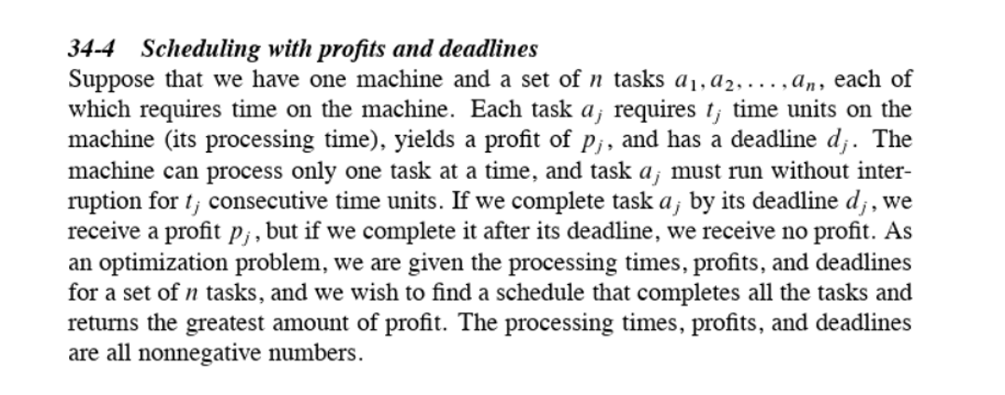
The Problem

Slide 3

Statement as Decision Problem & Proof of NP Completeness

Slide 4
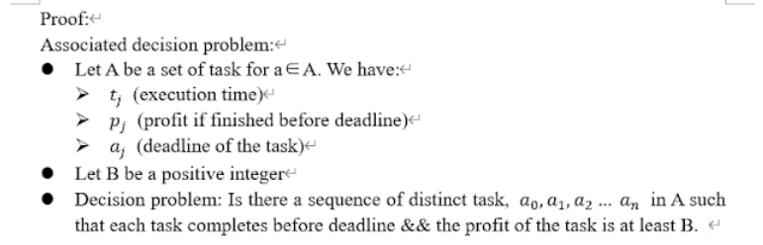
Statement as a Decision Problem

Slide 5
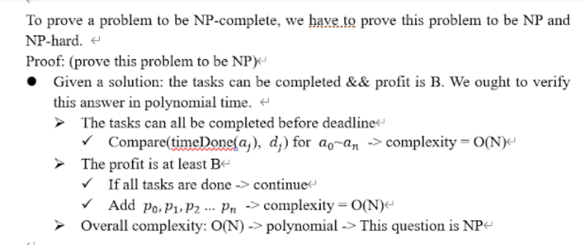
Proof of NP completeness

Slide 6
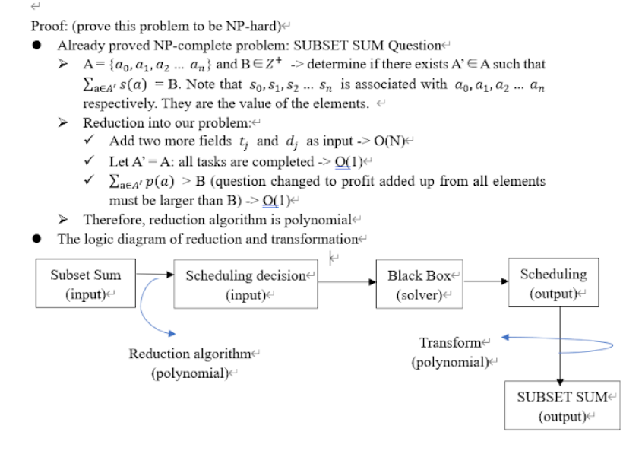

Slide 7
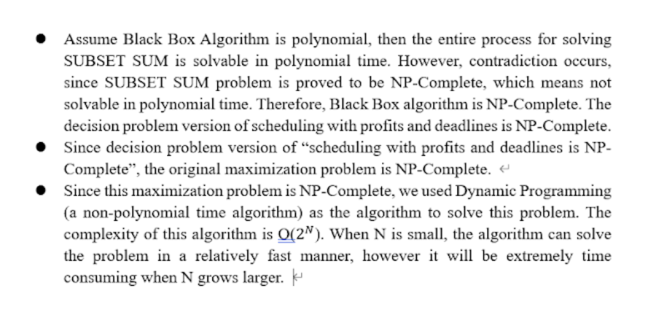

Slide 8
Algorithm for Decision Problem and Optimization Problem

Slide 9
Underlying Logic
General deadline
G < t_{i}：Task can’t be finished
G
t_{i} <= G < a_{i} & a_{i} < G:
Either finish the task or not

Slide 10
Optimization Problem: Algorithm Design
Objective:
Given a set of tasks, what is the optimal profit P?
Initialization:
Restructure the set of n tasks such that a₁ ≤ a₂ ≤ … ≤ a_{n}. Define Prof(j,G) to be the maximum profit obtainable when considering tasks 1, …, j with overall deadline G.

Slide 11
Optimization Problem: Pseudocodes
Initialize:
Prof(1,G) = 0 if t₁ > G
Prof(1,G) = p1 if t₁ ≤ G
for (2 ≤ j ≤ n){
for (1 ≤ G ≤ a_{n})}
if (G < t_{j}) => Prof(j,G) = Prof(j-1,G);
else if (t_{j} ≤ G ≤ a_{j}) => Prof(j,G) = max{Prof(j-1,G-t_{j}) + p_{j}, Prof(j-1,G)};
else (a_{j} < G) => Prof(j,G) = max{Prof(j-1,a_{j}-t_{j}) + p_{j}, Prof(j-1,G)};
return Prof(n,a_{n})

Slide 12
Decision Problem: Algorithm Design
Input: A profit P
Output: Yes or No, determined by whether or not P is a possible yielding by our problem instance
Restructure the set of n tasks such that a₁ ≤ a₂ ≤ … ≤ a_{n}. Define Prof(j,G) to be the maximum profit obtainable when considering tasks 1, …, j with overall deadline G.

Slide 13
Decision Problem: Pseudocodes
Initialize:
Prof(1,G) = 0 if t₁ > G
Prof(1,G) = p1 if t₁ ≤ G
for (2 ≤ j ≤ n){
for (1 ≤ G ≤ a_{n})}
if (G < t_{j}) => Prof(j,G) = Prof(j-1,G);
else if (t_{j} ≤ G ≤ a_{j}) => Prof(j,G) = max{Prof(j-1,G-t_{j}) + p_{j}, Prof(j-1,G)};
else (a_{j} < G) => Prof(j,G) = max{Prof(j-1,a_{j}-t_{j}) + p_{j}, Prof(j-1,G)};
if P ≤ Prof(n,a_{n}) => return YES
else => return NO

Slide 14
Program Demonstration

Slide 15
Thank You!

